Slide 1
Uniswap – a case study of decentralized exchanges on the blockchain
Nikolajs Korolkovs
Rezekne Academy of Technologies
Notes:
Hello everyone! My name is NK and I’m a senior undergrad student at RAT. I’m studying CS. Today I’d like to tell you about DeFi and AMMs.

Slide 2
Pros and Cons of DeFi exchanges vs. CeFi exchanges
Central Limit Order Book (CLOB) – NYSE, Binance, Nasdaq.
Automated Market Maker (AMM)-based decentralized exchanges(DEX) on the blockchain – Uniswap, Curve, Balancer.
The goal is to compare CLOB-based Centralized Finance(CeFi) exchanges to AMM-based Decentralized Finance(DeFi) DEXes using Uniswap DEX as an example.

Slide 3
Ethereum
Blockchain – a digital immutable ledger of transactions.
Byzantine generals problem - a game theory problem, which describes the difficulty decentralized parties have in arriving at consensus without relying on a trusted central party.
Bitcoin solved the Byzantine generals problem using cryptography and Proof-of-work algorithm.
Ethereum – a fork of Bitcoin, that introduced a Turing-complete Ethereum Virtual Machine(EVM) – a distributed computational network.
Smart Contracts – programs that automatically execute transactions if certain conditions are met, without the need of an intermediary.
Ethereum Gas - unit that measures the amount of computational effort required to execute specific operations on the Ethereum network.
Notes:
Let’s just quickly establish some things. Contract - an account controlled by an immutable program.

Slide 4
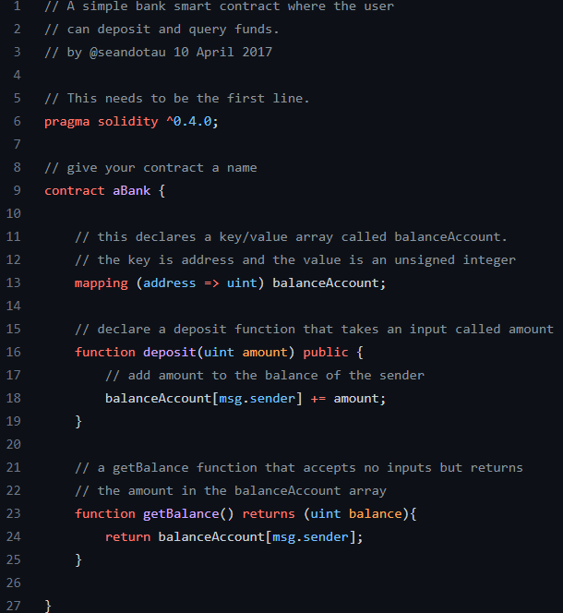
Example of a smart contract
Notes:
Nothing scary, got your functions and state variables. a state container with some functions to mutate it. Like objects in OOP. This contract is insecure – just show the syntax.

Slide 5
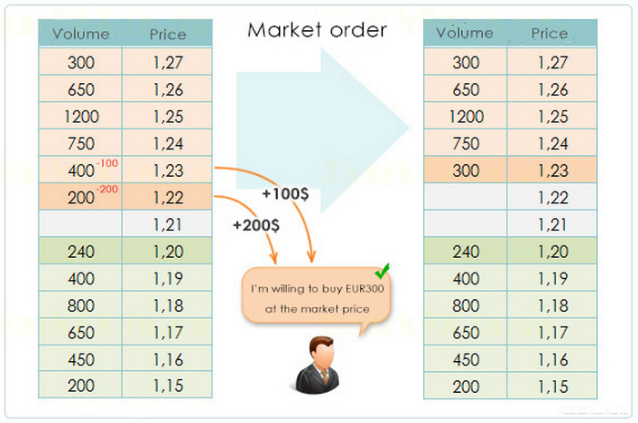
CLOB-based exchange
Notes:
Central limit order book. Market makers set sell/buy orders. To execute a trade the trader needs a counterparty that puts up an order.

Slide 6
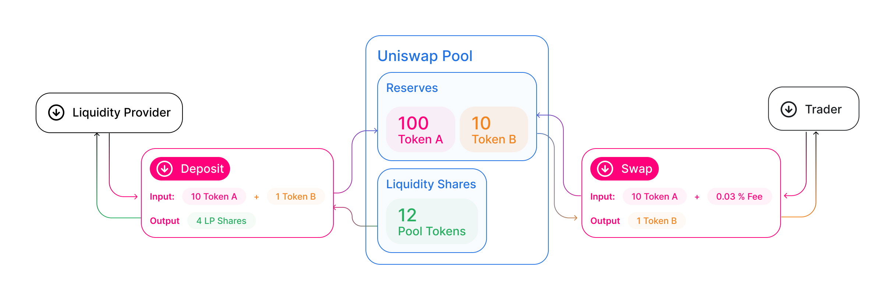
AMM-based exchange. Protocol layer of Uniswap
Notes:
Liq shares - tokens issued to LPs that are used to track individ contr to the overall LP.
LPs collect a fee from each trade performed in a pool that is proportional to their contribution to the pool.

Slide 7
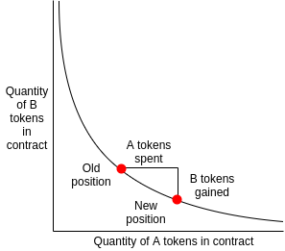
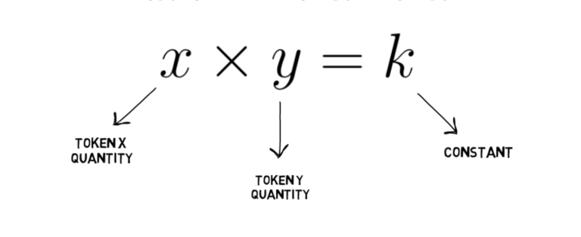
Price impact of a trade. Constant product formula.
Image source: https://ethresear.ch/t/improving-front-running-resistance-of-x-y-k-market-makers/1281
Notes:
CPF – formula, that is used to price assets in a pool. Can see the result of a price change after a large trade in a chart on the left. Ratio changes -> price changes. This changes of price during a trade in AMM DEX is called slippage.

Slide 8
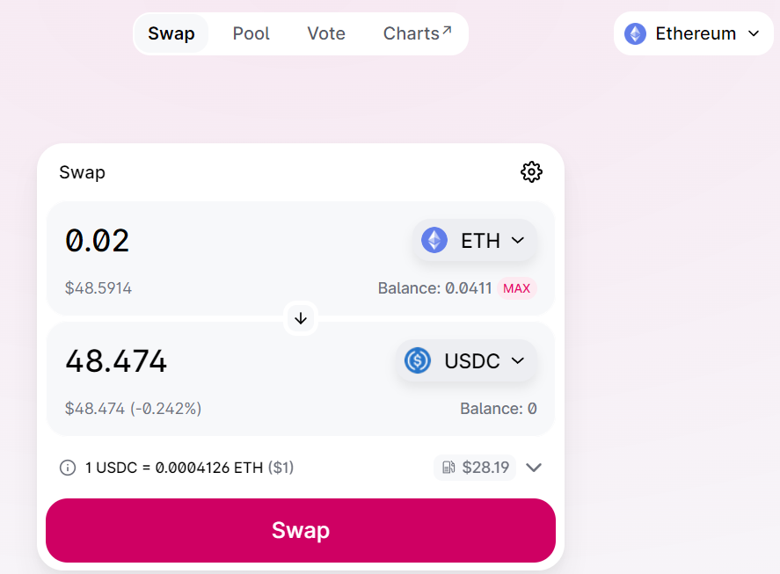
User-facing interface. Application layer of Uniswap
Notes:
Regular web app, hosted in the cloud, connects to a smart contract on the blockchain using Ethereum RPC nodes.

Slide 9
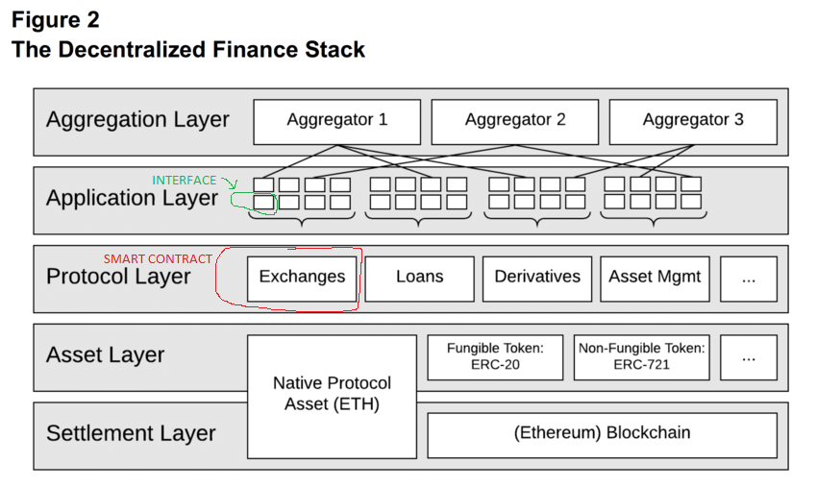
The place of Uniswap in the DeFi stack
Notes:
You can see here where different parts of Uniswap land on the DeFi stack. Can have different web applications interacting with the same smart contract. Can use a script to connect to a smart contract, no need for a web app/browser. That’s how trading bots operate.

Slide 10
AMM PRO: Non-custodial = censorship-resistance
Trustless blockchain networks + permissionless and immutable nature of smart contracts = potential to deny one authority the power to prevent users from using the platform.
In immutable trustless DeFi protocols only smart contract risk can prevent investors from getting their funds out or selling their assets.
Not even a bank run can bring these protocols down. A spike in trading activity => lots of transactions competing for limited block space => high gas fees.
Up ahead – a short recap of market manipulation by Binance CEX with UST/LUNA cryptocurrencies that happened in May 2022.
Notes:
One authority cannot prevent users from using the platform cause of trust perm immut. Smart contract risk is the only thing that could prevent people from getting their funds out. More on that later.
Unlike a recent situation with UST/LUNA on Binance, the biggest CEX, not even a bank run and widespread panic can prevent people from selling their assets.

Slide 11
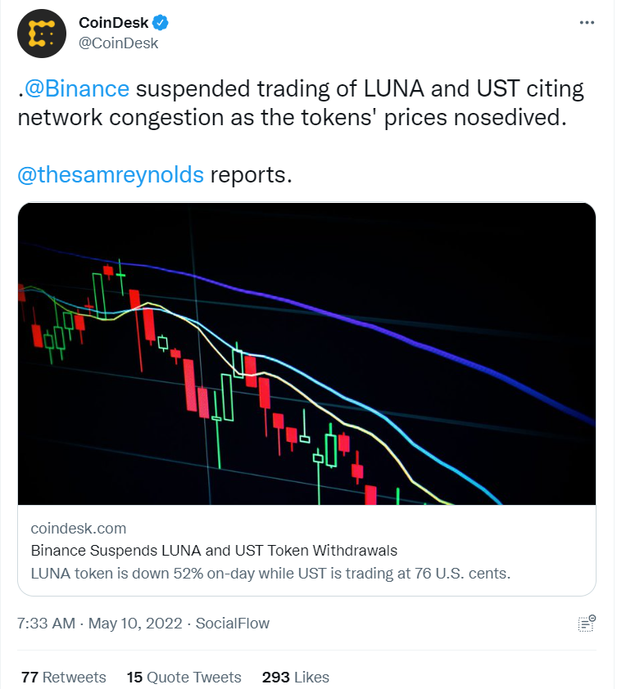
An example of CeFi censorship
Notes:
An example of Binance arbitrarily suspending trading on select tokens. This is what a central authority denying the users access to their assets looks like. And this is the problem DeFi solves.

Slide 12
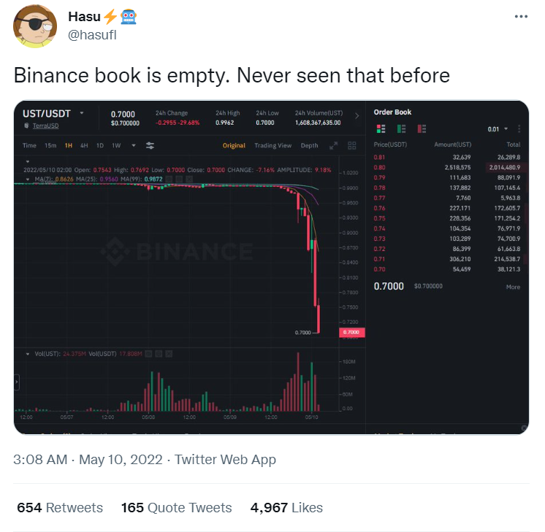
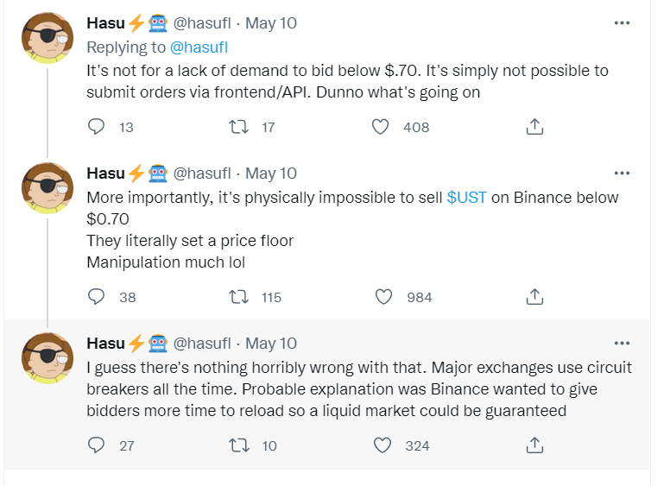
UST/LUNA crash of May 2022
Notes:
This is market manipulation, and Hasu, one of the leading crypto researchers, agrees.

Slide 13
DeFi/AMM Pro: Flash Loans
Flash loans - special transactions that allow the borrowing of an asset, if the borrowed amount (and a fee) is returned within the same transaction block.
Popularized by Ethereum based lending protocol AAVE in January of 2020.
Implemented using smart contracts. Made possible due to atomic nature of blockchain transactions.
Flash loans require no collateral.
Used for arbitrage, swapping collateral and in liquidations.
Because of their trustless and permissionless nature they have been used for flash attacks, a way to exploit DeFi protocols. Examples - Cream Finance, Beanstalk, bZx.
Notes:
This is more of a DeFi feature, but AMMs are benefitting from it and there’s nothing close to this available to traders in CeFi. Loans in CeFi require trust, credit, collateral..

Slide 14
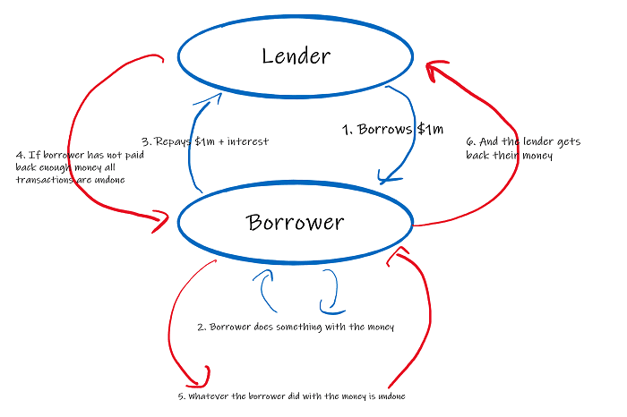
Flash Loans. Transactions. Atomicity
Notes:
If one of transactions fails or the money is not returned before the end of transaction block, then all the transactions get rolled back and the tokens get returned to the lender.

Slide 15
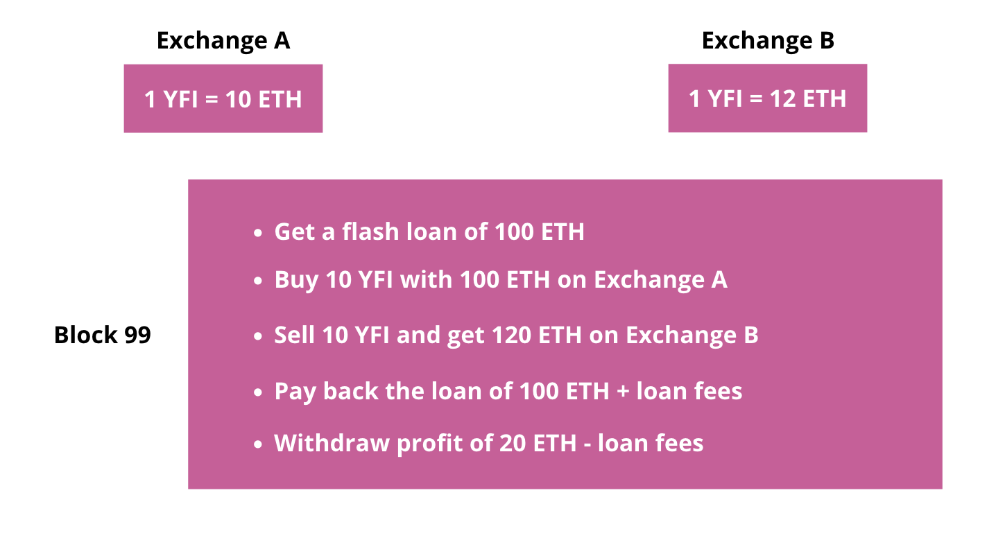
An example of a flash loan
Notes:
Arbitrage that takes advantage of price differences on different DEXes. This is done by trading bots that are competing against each other to take advantage of arbitrage opportunities.

Slide 16
Other AMM advantages
Relying on arbitrage to keep up with global market price means arbitrageurs generate extra trading volume on the exchange, which is good for liquidity providers.
Potential for deeper liquidity. https://uniswap.org/blog/uniswap-v3-dominance
Uniswap V2/V3 can be used as a price oracle. Price oracle – a tool used to view price information about a given asset. Uniswap is providing time-weighed average prices (TWAP) of assets.
The ease of becoming a market maker. Revolutionary opportunity with significant counterparty risks, such as adverse selection and principal-agent problem.
Notes:
All the trading bots that constantly participate in arbitrage generate a lot of trading volume that is good for LPs. Since a smart contract on a blockchain cannot interact with entities outside of the blockchain if it requires token price information it can use an oracle smart contract. Uniswap offers an implementation of such a price oracle.

Slide 17
AMM/DeFi Con: Smart contract risk
Compiled bytecode and state of all the deployed smart contracts on the Ethereum blockchain are public.
Anyone can analyze the code to try and find an attack vector.
Bugs/inefficiencies/logic errors get exploited on a regular basis. Examples: DAO hack, Beanstalk, bZx flash attack.
New industry has emerged to try and solve the problem – smart contract security auditing. Some of the well-known auditors: Peckshield, QuantStamp, Trail of Bits.
Notes:
Unlike prop software, bytecode and state of contracts of DeFi apps are available to the public. This means anyone can analyze the code to try and find an exploit.
Sec aud is an expensive glorified code review, but that’s often the best defense that you can have as a developer against adversaries. And Ethereum is a highly adversarial environment.

Slide 18
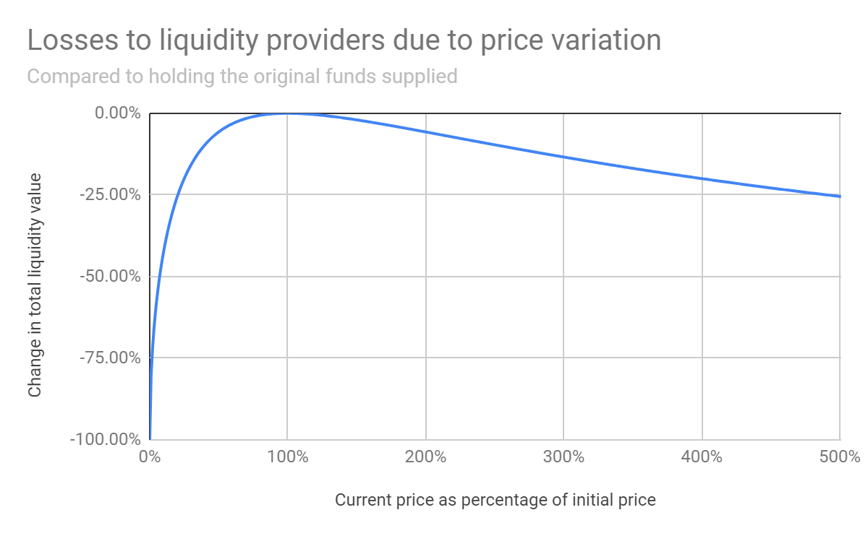
AMM Con: Impermanent loss
Notes:
IL happens when the price of your tokens changes compared to when you deposited them in the pool. The larger the change is, the bigger the loss.

Slide 19
Price impact of a trade. Constant product formula.
Image source: https://ethresear.ch/t/improving-front-running-resistance-of-x-y-k-market-makers/1281
Notes:
Just a reminder – in the chart on the left the ratio of tokens has changed after a trade and it will lead to IL for the MMs/LPs. And we’ll also need a CPF for the example from the next slide.

Slide 20
Impermanent loss example
Before: The price of 1 ETH = 1000 USDT
You supply 10 ETH and 10000 USDT to a liquidity pool
The price of ETH doubles to 2000 USDT
Arbitrageurs from outside of Uniswap come in and buy all the ETH in the pool until the price reaches 2000 USDT and matches external exchanges. Let’s assume for the sake of simplicity of this example that the liquidity providers get no fees
Based on the x * y = k formula, the liquidity pool will now consist of:
7.071 ETH and 14142.1 USDT
At the new ETH price of $2000, the total value of your holdings in the liquidity pool would be: $14142.1 + $14142.1 = $28284.2
If you just held on to your original 10 ETH and 10000 USDT, the total value of your holdings outside of the liquidity pool would now be: $20000 + $10000 = $30000
Your impermanent loss is: $30000 – $28284.3 = $1715.8
Notes:
Let’s imagine 1 ETH costs 1000$.

Slide 21
AMM/DeFi Con: Non-custodial nature
Even though direct and complete control over your digital assets without the services of intermediaries is an amazing technological invention, it has some risks as well.
Sending money to the wrong wallet or losing your private key means that your funds are lost forever, which is not likely to occur under the protection that traditional banking provides.
Cryptocurrency CEXes (Binance, Coinbase, Kucoin, etc.) can help people recover access to their account in case they forget their password/lose their phone/etc.
Notes:
Unlike in CeFi, when you make a mistake or forget the private key that gives you access to your crypto wallet there’s no entity that you can call and complain. If you lose access to your wallet your funds are lost forever. In CeFi there are safeguard and procedures that help in situations like that.

Slide 22
Investing in DeFi
The practitioner’s guide to becoming a millionaire in DeFi.
Notes:
Enough theory! I wanted to show you something practical today, so let’s learn how to become a millionaire in DeFi.

Slide 23
Investing in DeFi
The practitioner’s guide to becoming a millionaire in DeFi.
Step A. Invest a billion dollars into DeFi. Buy a portfolio of tokens that you barely understand.

Slide 24
Investing in DeFi
The practitioner’s guide to becoming a millionaire in DeFi.
Step A. Invest a billion dollars into DeFi. Buy a portfolio of tokens that you barely understand.
Step B. Wait.

Slide 25
Investing in DeFi
The practitioner’s guide to becoming a millionaire in DeFi.
Step A. Invest a billion dollars into DeFi. Buy a portfolio of tokens that you barely understand.
Step B. Wait.
Step C. Congratulations! You lost most of your money and you’re a millionaire now!

Slide 26
AMM/DeFi Con: Counterparty risks
The practitioner’s guide to becoming a millionaire in DeFi.
Step A. Invest a billion dollars into DeFi. Buy a portfolio of tokens that you barely understand.
Step B. Wait.
Step C. Congratulations! You lost most of your money and you’re a millionaire now!
This is an example of one of counterparty risks in DeFi – adverse selection. It’s a situation in which sellers have more information about a product’s quality than buyers or vice versa. In other words, it’s a situation in which asymmetric information, also known as information failure, is used.
P.S. DO NOT REPEAT AT HOME!
Notes:
This happens all the time. Anyone can fork a protocol, create a token and list it on a DEX. Start promoting it on social media, promising crazy returns. DeFi is filled with Ponzi schemes.

Slide 27
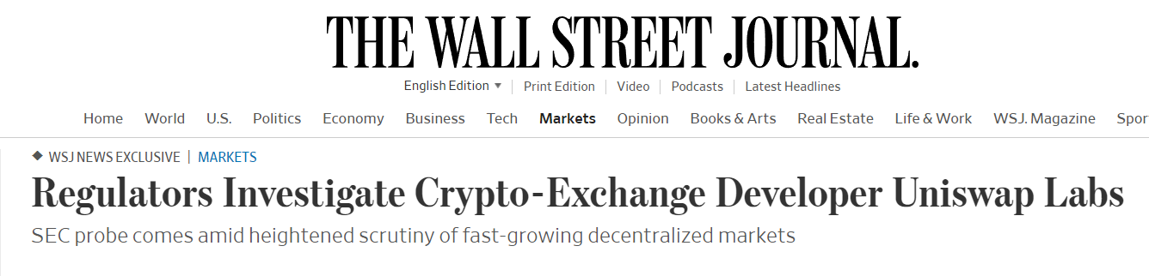
AMM Con: Regulatory challenges
Will Uniswap terms of service and disclaimer protect the developers of the project from the SEC when it decides to regulate DEXes that are using smart contracts on the blockchain to facilitate trading?
Notes:
This is an open question right now and one of the risks investors must consider.

Slide 28
Other AMM/DeFi disadvantages
Frontrunning, a result of Ethereum having a public pool of pending transactions called mempool. It allows trading bots to abuse retail traders. This is similar to High-Frequency Trading (HFT) in traditional stock markets.
Bad user experience due to additional layer of complexity of having to deal with non-custodial wallets.
Periods of high network activity can lead to unexpected spikes in gas fees which can lead to stuck transactions.
Trade settlement speed is slower than in a centralized solution.
Low capital efficiency in V2 Uniswap pools and their forks (SushiSwap, PancakSwap).
Notes:
Unfortunately, I cannot go into details on a lot of these because of time constraints for this presentation.

Slide 29
Conclusions
Despite their problems with scalability, blockchain solutions are constantly evolving and soon might be able to compete with centralized solutions.
DeFi is here to say – it has a real use case, has a well-defined niche and a target audience.
DeFi is in the era of constant innovation, it’s high-risk and high-reward, so need to take immense DeFi risks into account. Today DeFi is only attractive to risk-tolerant investors, which are a small group.
Regulation is slowly creeping into DeFi, some lending platforms like Maple Finance and Aave Arc are compliant with KYC and AML. Soon DeFi might become a viable option for institutional investors.
Why would you trust a project that has a pseudonymous owner? If the smart contracts are immutable, you don’t have to trust the person – you can trust the code.
Usability is a question mark, might require more innovative solutions.

Slide 30
Want to know more?
This presentation and all the links are available at: https://github.com/nickeu/defi
“Blockchain and money” course by Gary Gensler at MIT:
https://ocw.mit.edu/courses/15-s12-blockchain-and-money-fall-2018/
“Decentralized Finance” course at UC Berkeley
https://berkeley-defi.github.io/f21
“Decentralized Finance (DeFi): The Future of Finance” specialization offered by Duke University on Coursera
https://www.coursera.org/specializations/decentralized-finance-duke
“Cryptozombies” an interactive Solidity programming language tutorial suitable for beginners. https://cryptozombies.io/

Slide 31
Thank you
for your attention
Any questions???

